Slide 1




MINESHIELD
Smart Mine Safety & Monitoring System
Real-Time Hazard Detection & Safety Management

Slide 2
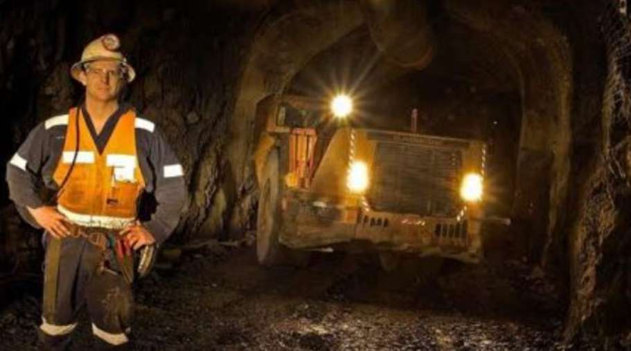
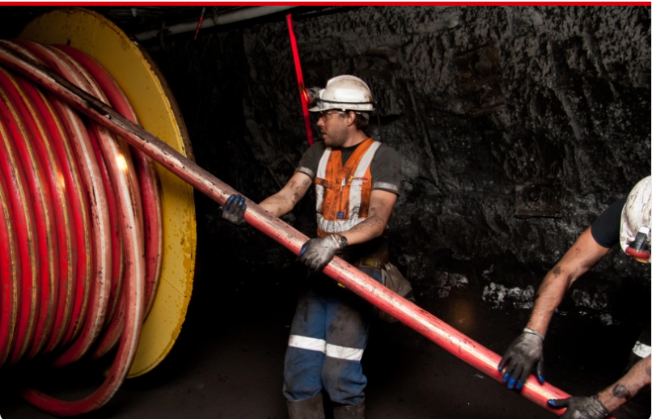
Problem Definition
Outdated Systems: Traditional mining, relies on manual methods to report onsite hazards.
Critical Delays: Inefficient response times to emergencies can lead to severe accidents.
Lack of Visibility: Supervisors lack real-time insights into worker locations and site conditions.
Reactive Reporting: Incident reports often occur after damage is already done.

Slide 3

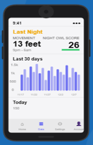
Solution MineShield
Modern Safety at Your Fingertips
MineShield leverages smartphone sensors and cloud technology for real-time hazard detection. Accessible from any Android device, the system provides:
Instant reporting with high-quality image uploads.
Automated alerts for fall detection and noise exposure. Live supervisor dashboards with advanced analytics.

Slide 4


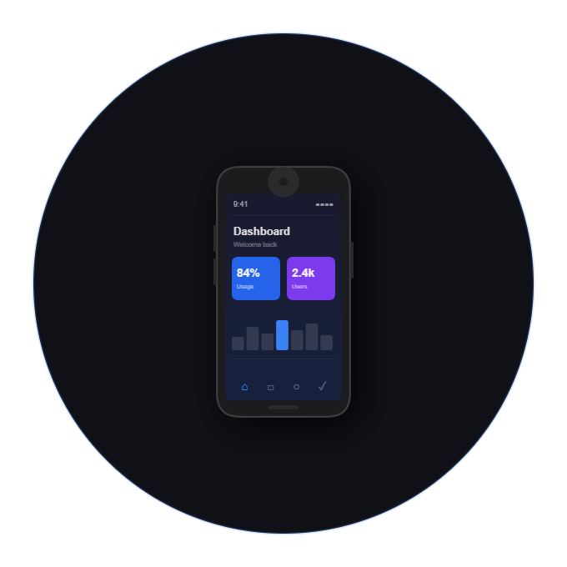
System Architecture
React Native Frontend
Firebose Backend
Smartphone Sensors
Cross-platform mobile application providing an intuitive UI for workers, supervisors, and safety officers..
Cloud infrastructure for user authentication, data storage, real- time alerts, and secure role-based access control.
Utilizing built-in accelerometers and microphones for automatic fall detection and noise monitoring.

Slide 5
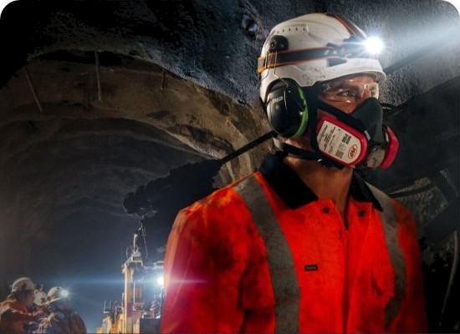
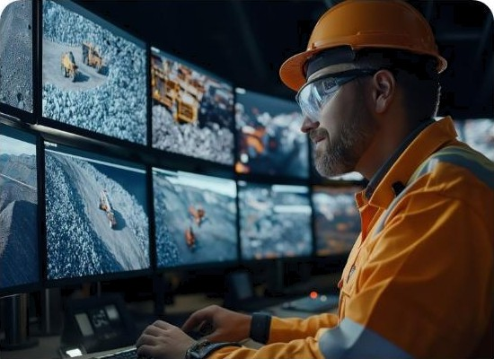
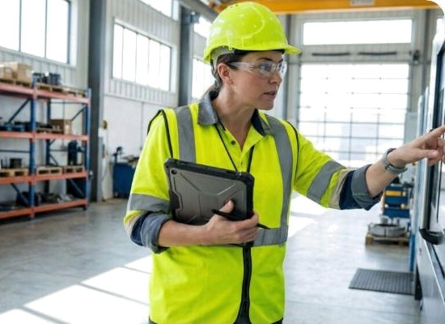
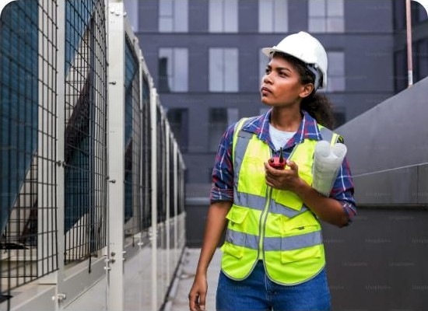
Target Users
Mine Workers
Supervisors
Safety Officers
Visitors
Frontline staff requiring real-time hazard alerts and SOS capabilities..
Team leaders monitoring safety across assigned zones and alerts..
Analyzing safety trends and implementing preventive measures.
Site visitors requiring zone-specific safety info and monitoring.

Slide 6
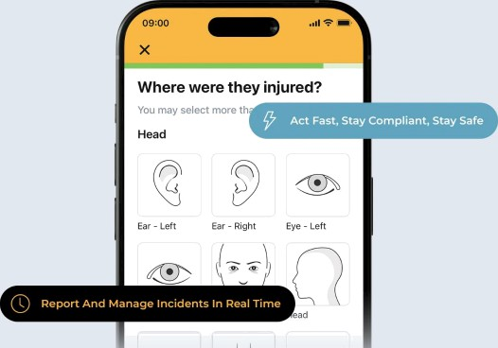
Functional: Hazard Reporting
Real-Time Identification
Workers can register with role-based access to document safety concerns instantly. Keyfeatures include:
Visual Documentation: Attach high-res images to reports for context.
Role-Based Access: Specific permissions for workers and safety teams.
Quick Response: Alerts sent instantly to relevant supervisors for action.

Slide 7
Mapping & Fall Detection
Interactive Hazard Mops
Automated Fall Detection
MineShield provides live mapping showing danger zones across the mine site. Visual overlays allow workers to avoid high-risk areas during their shift.
Built-in accelerometer analysis detects sudden impacts. If a fall is detected, an automatic SOS alert with GPS coordinates is broadcast to emergency teams.

Slide 8
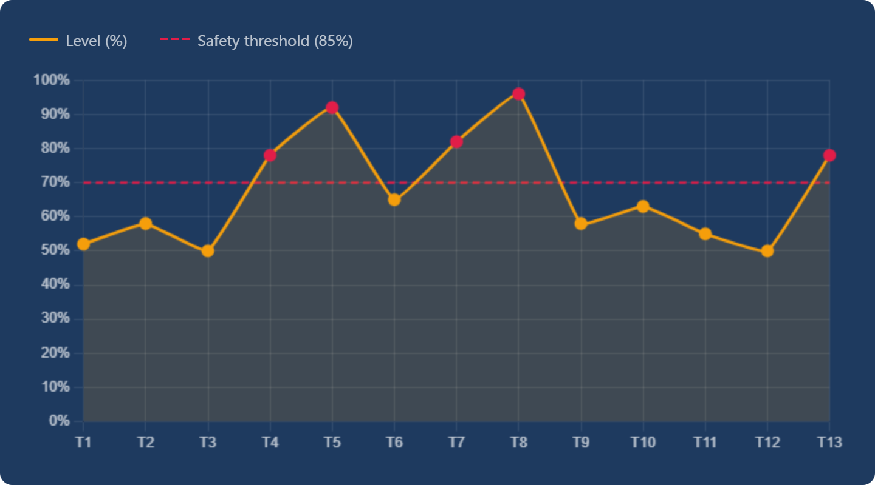
Noise Monitoring
MineShield continuously monitors ambient noise levels via smartphone microphones to prevent long-term hearing damage.
Alerts are triggered when decibel thresholds exceed safe exposure limits.

Slide 9

Supervisor
Gas Hazards
Equipment Failure
60 % Priority
Worker Falls
Noise Violations
Real-time analytics provide comprehensive insights into hazard trends, worker locations, and alert histories for informed decision-making.

Slide 10
Non-Functional Requirements
Performance: Dashboard loads within 3s for optimal experience.
Security: Data encryption and RBAC to protect sensitive information.
Usability: Simple UI designed for high-stress emergency reporting.
Reliability: Offline buffering preserves data during connectivity gaps.
Compatibility: Optimized for modern Android (10+) devices.

Slide 11
Key Base Cases
Report Hazard
Fall Detection
Monitoring
e
Workers report hazards with images and location for review.
Sensors automatically trigger SOS alerts to officers.
Supervisors track hazards and safety trends live.

Slide 12
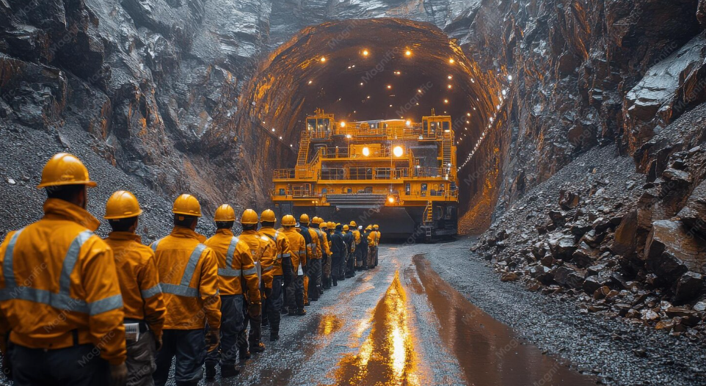
Conclusion & Q&A
MineShield represents a transformative approach to mine safety, bridging the gap between conventional measures and digital innovation.
By leveraging existing smartphone hardware, we offer a cost- effective, real-time solution that empowers every worker on-site.
Thank You!
Presented by: MineShield Development Team

Slide 13


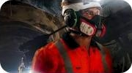
Image Sources
https://IunitraveIs.com/wp-content/upIoads/ashio-copper-mine-museum-train-track-tunneI-entrance-IunitraveIs.webp
Source: IunitraveIs.com
https://assets.repIocdn.com/projects/54c4a11b-3548-485c-88a7-e37c4248e64a/429cc87d-bce8-44bb-88ee-O73OceOeódOc Source: shop.drivemedicalathome.com
https://us.pipgIobaI.com/images/mining-workers-1.JPG
Source: us.pipglobaI.com
https://www.magnific.com/premium-ai-image/underground-mine-workers-yellow-safety-gear-observe-large-mining-equipment-deep-gold-mine-tunnel-illuminated-by-bright-lights_360378810.htm

